Slide 1







1

Slide 2




Working with SQL Server for Linux Cross-Platform PowerShell Core & Python
Maximo Trinidad
Technology Evangelist
Twitter: @maxtrinidad

Slide 3
Agenda
1
1
Understanding Your Environment
2
PowerShell and SQL Server
3
Python SQL Connectors
4
Questions
5
Reference Information

Slide 4

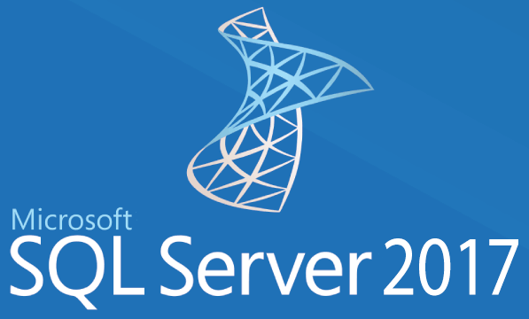


Understanding Your Environment

Slide 5
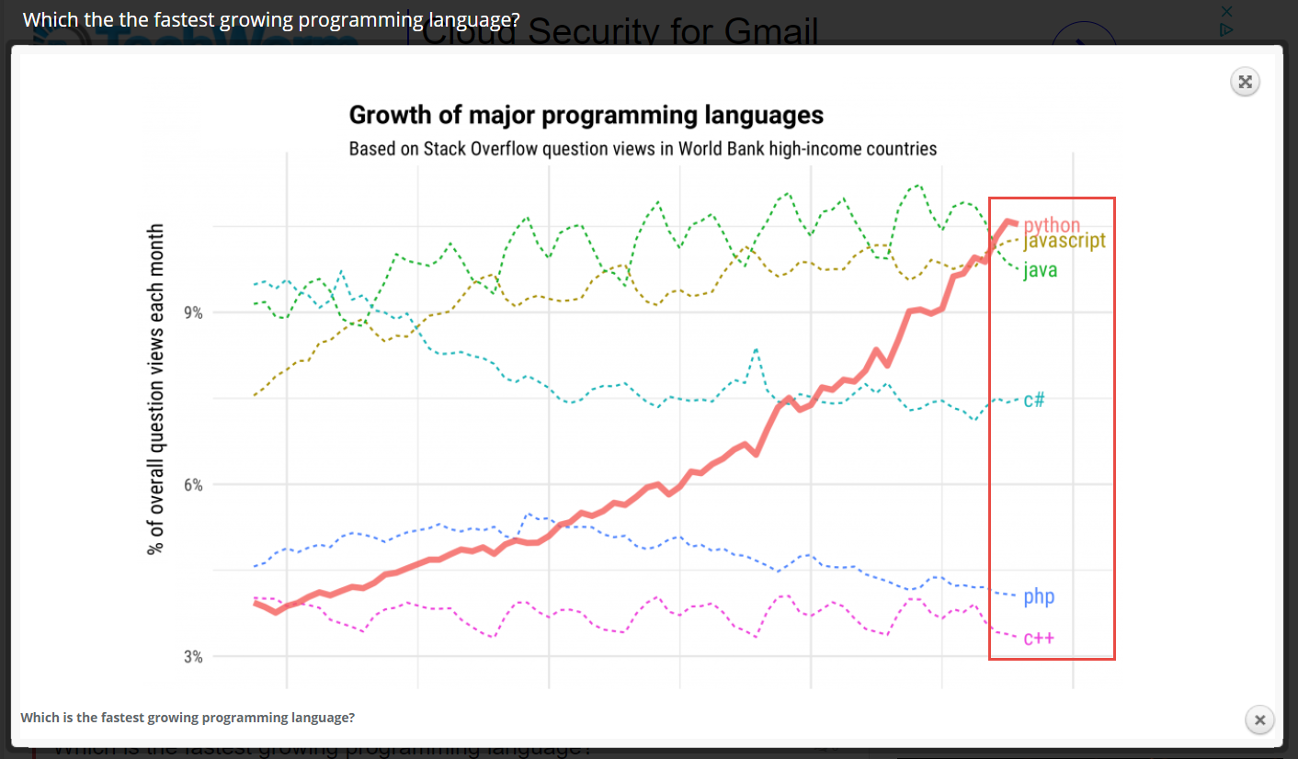
Top Demand Programming Languages
3
https://www.techworm.net/2017/09/fastest-growing-programming-language.html

Slide 6
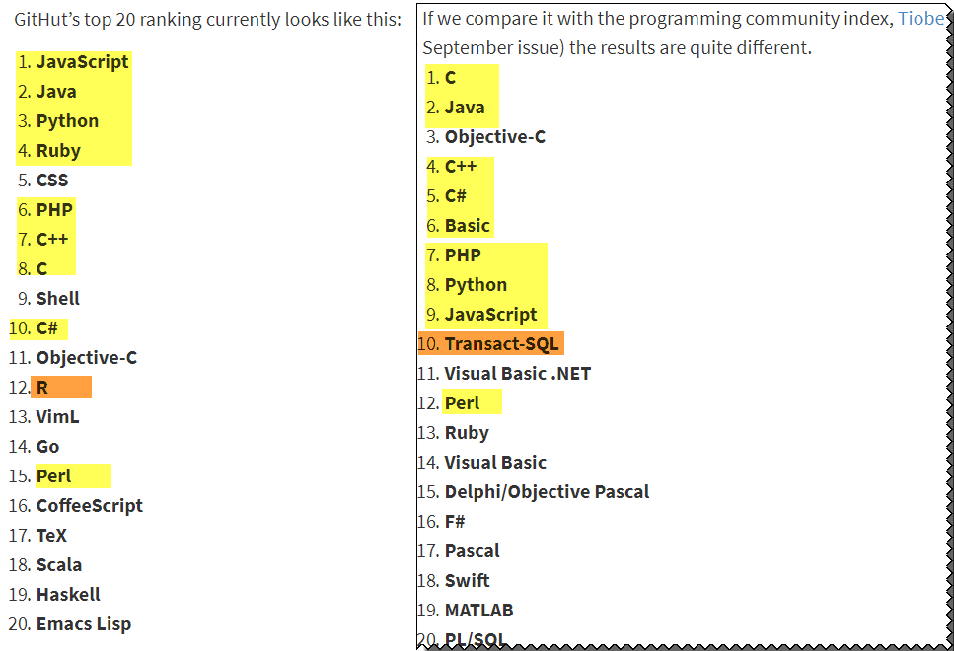
Top Demand Programming Languages

Slide 7
Understanding Your Environment
4
- Install component in both Windows and Linux
- PowerShell Core Open Source
- Linux and Windows use Anaconda Python 3.6
- Include - Python Tcl/Tk & SQL Connectors
- Use OneDrive
- On Bash access (/mnt/c/Users/#username#/OneDrive)
- On Linux access Windows shared folders
-Install OpenSSH
- ssh Linux -> Windows, Windows -> Linux
- PowerShell ssh remoting both ways

Slide 8
Understanding Your Environment
5
- You're New to Linux
- Get “Ubuntu” from Microsoft Store
- Install "Ubuntu Desktop"
- PowerShell
- Anaconda (Python 3.6)
- Cross-Platform Editor
- VS Code lightweight Multi-language editor
- Other Editors
-PrimalScript – Multi-language editor (Windows only but can use SSH)
-Brains PyCharm (Robust Python Editor Windows and Linux)
-VIM, GEDIT, EMACS24..
*Use Windows Editors to create code

Slide 9
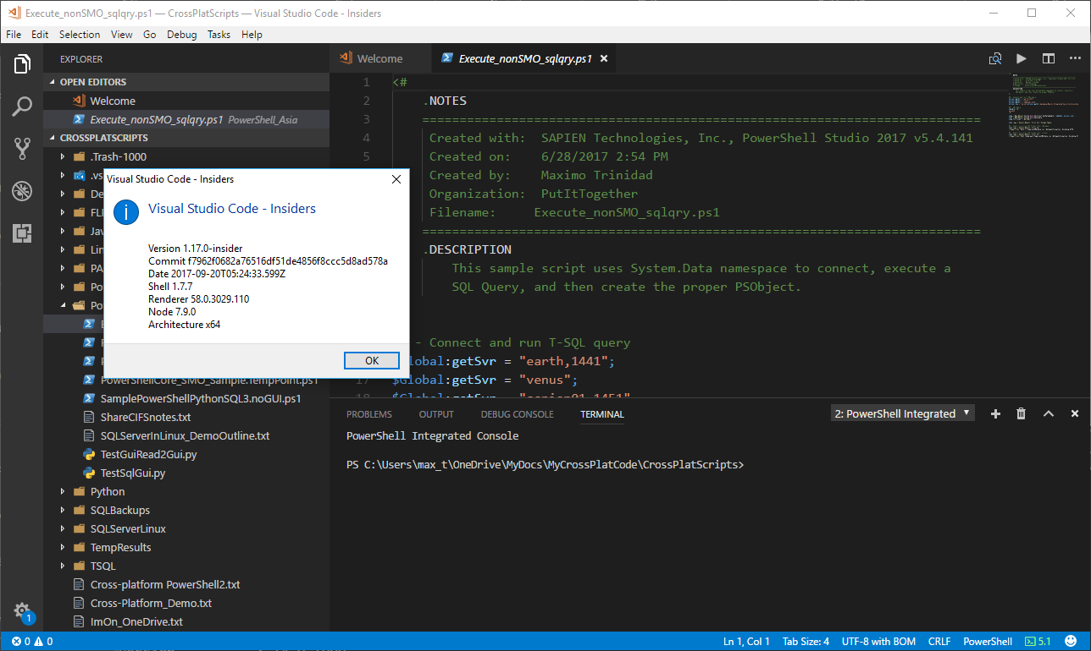
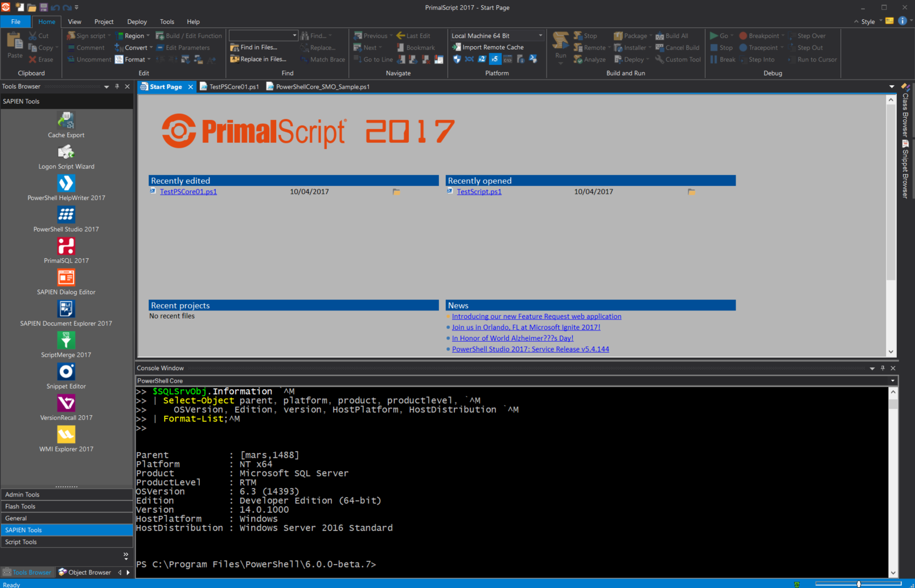
Understanding Your Environment
Tools: VS Code, Sapien PrimalScript

Slide 10
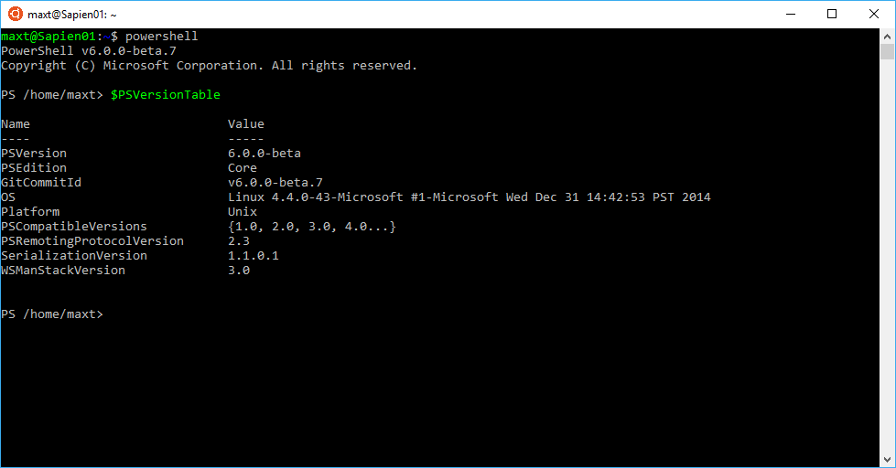
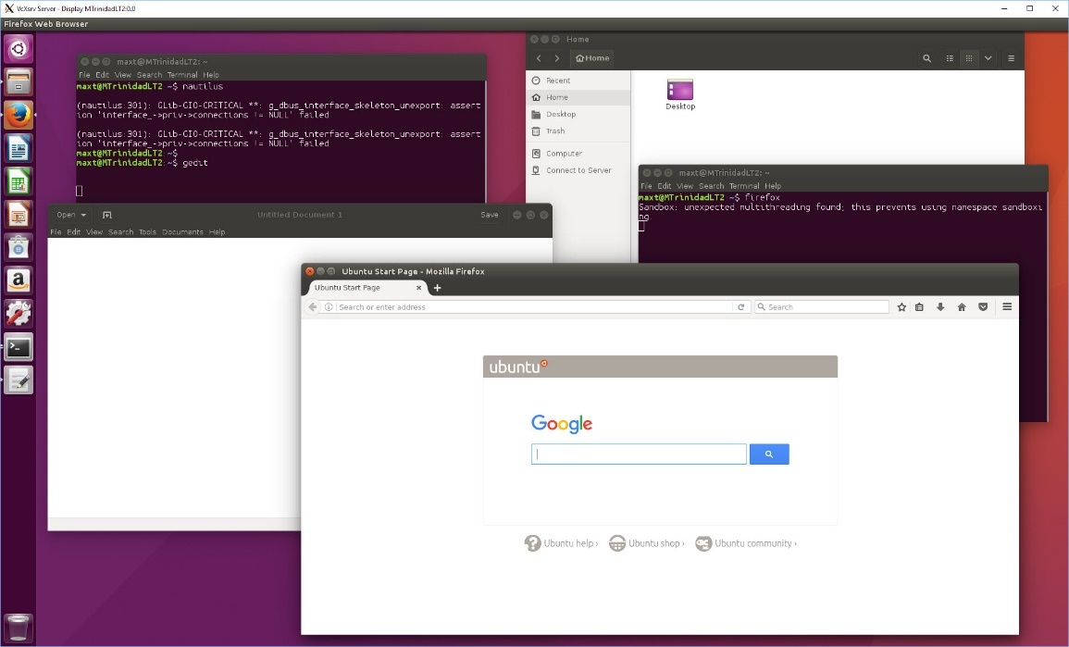
Windows 10 - Ubuntu
6
Understanding Your Environment

Slide 11
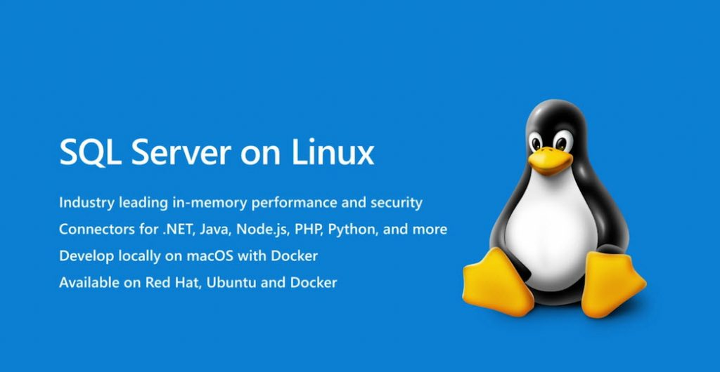
Understanding Your Environment

Slide 12
Understanding Your Environment
5
- SQL Server 2017 on Linux
- Version RTM (GA) is available
- Production Ready
- SQL Agent
- Integration Services
- Full Text Search
- Azure Ready
- MSSQL Tools includes:
- ODBC Connectors (MSODBCSQL)
- SQLCmd
- No PowerShell SQLPS Commands available
- Use PowerShell Core with either:
- SMO for Linux (Available)
- Use ADO.NET - System.Data

Slide 13
Understanding Your Environment
- SQL Server 2017 on Linux ( more )
- Authentication Mode:
- SQL Server Authentication
- Windows Authentication
- Administration Tools:
- Windows SSMS 2017
- Linux (?) - > VS Code
- On Windows Client machines:
- Could use Windows PowerShell modules:
- *SQLPS (SQLServer 2016 (prior) and 2017)
- **SQLServer (PsSGallery)
- Other Community SQL Tools:
- DBATOOLS
- DBAReports
*Note: Be aware, having different versions of SQL Server on a single box will
installed multiple version of SQLPS module in your PSModulePath.
**Note: This is a SQL DBA Community-based module meant to replace SQLPS
module later on.

Slide 14
PowerShell and SQL Server
7
- SQL Server PowerShell scripting
- In Windows Only: (Windows PowerShell)
- Two PS Modules available:
* SQLPS (SQLServer installation)
* SQLServer (PowerShell Gallery)
- SMO (SQL Server Management Objects) in PowerShell Core
- Windows SQLPS module will not execute
- .NET Core SMO Dll installation required.
- SMO will work in both Windows and Linux.

Slide 15
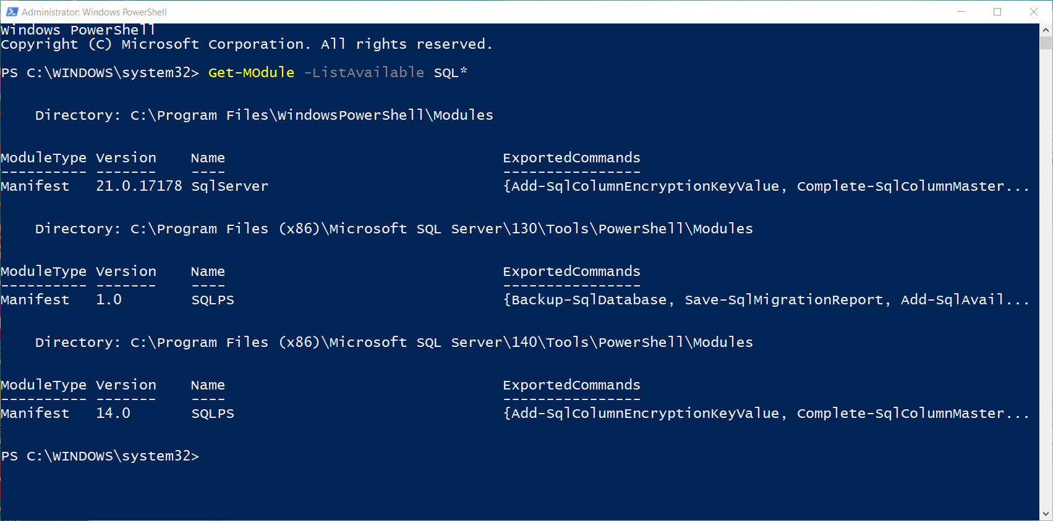
PowerShell and SQL Server

Slide 16
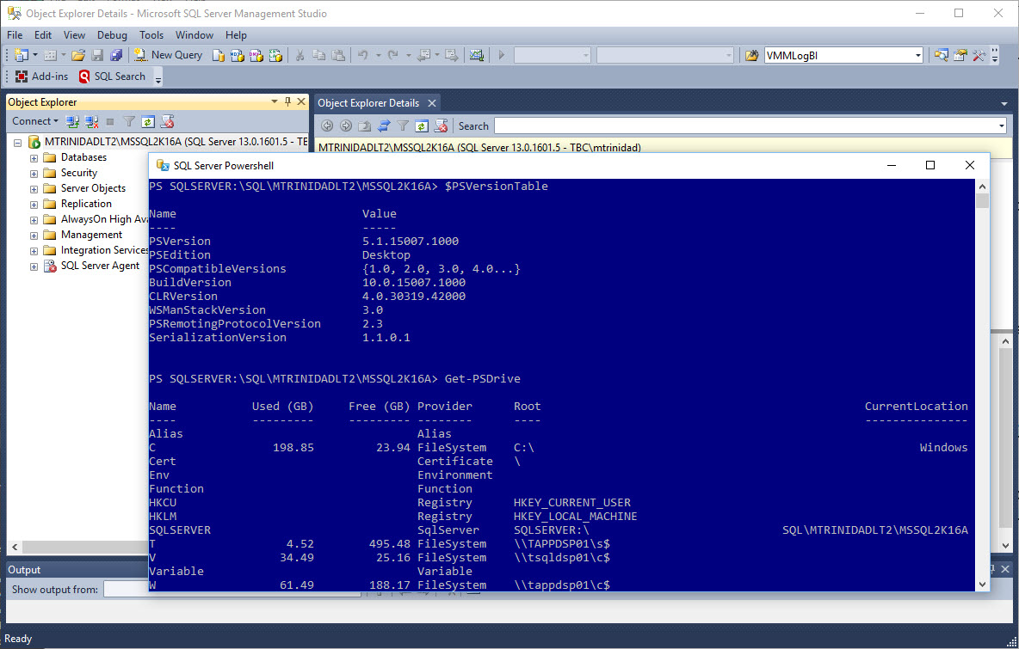
PowerShell and SQL Server
8

Slide 17
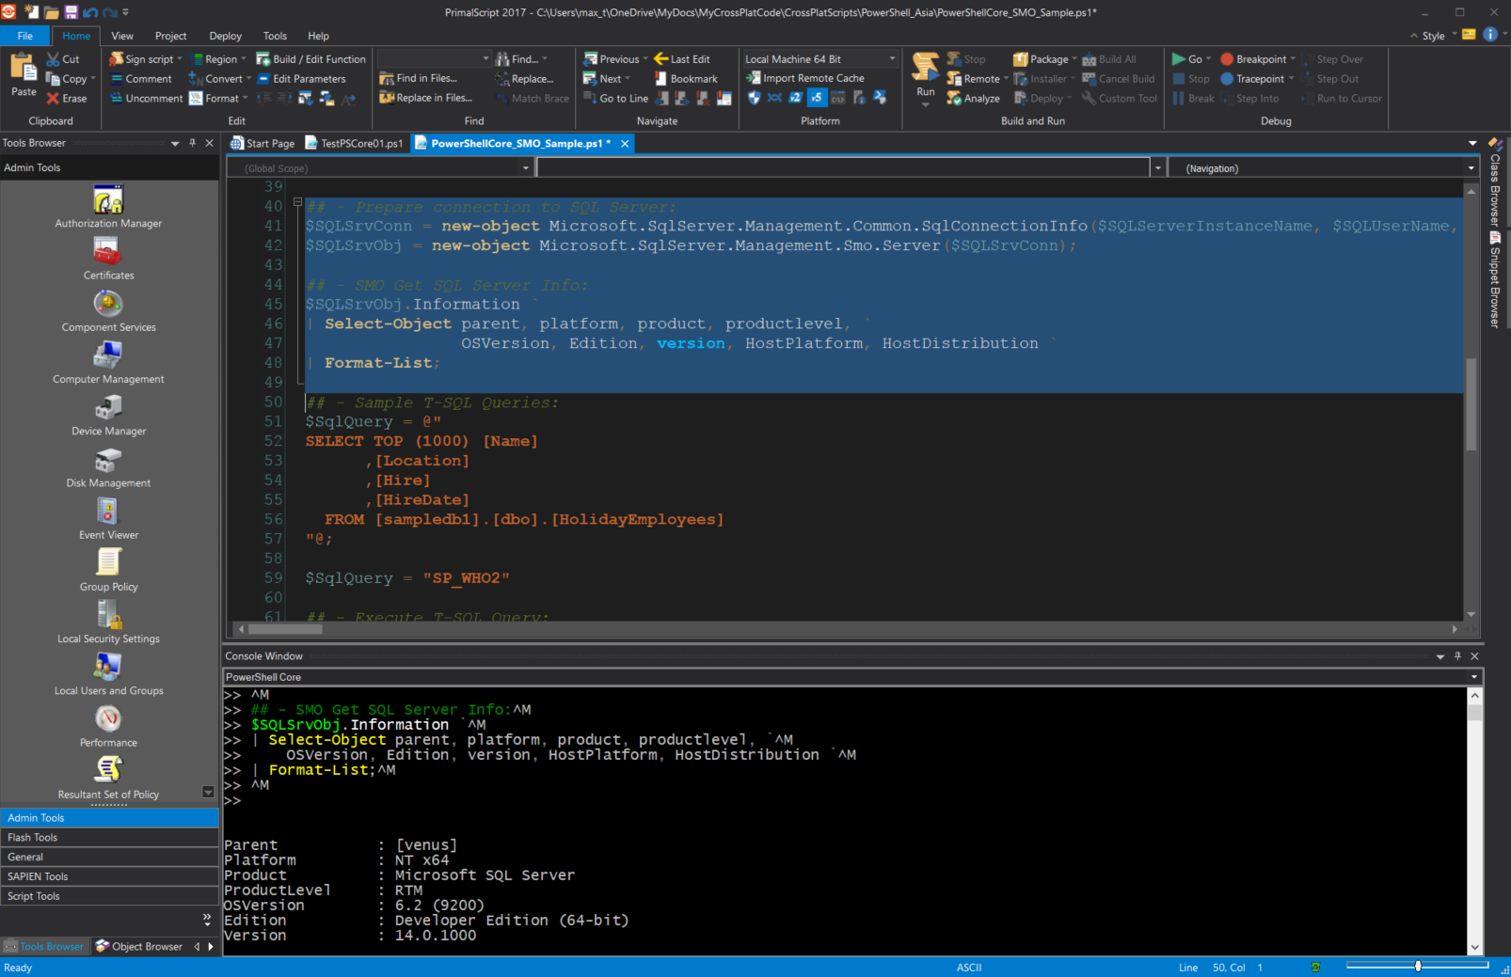
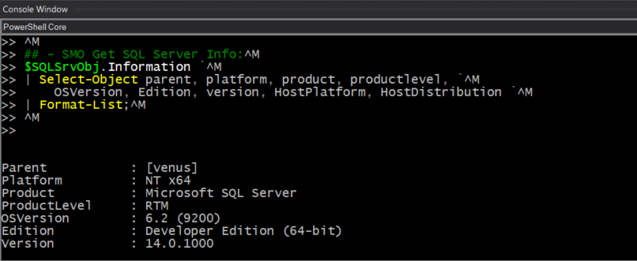

PowerShell and SQL Server
9

Slide 18
Connecting to SQL Server with Python
10
Choose a Python version
Use “sudo su; Update-Alternatives” command
update-alternatives --list python
- Two SQL Connectors
- pyodbc
- pymssql (not covered)
- Connectors Behavior
- pyodbc and pymssql can connect to
- Windows local and Multi-instance SQLServer
- Linux only single instance
- Python with PowerShell (for data collection, and Tasks automation)
- Possibility of Cross-platform solutions
- Take advantage of .NET objects in Linux

Slide 19
Demo
11
1. Using you tools
VS Code, PoweShell Core, Anaconda Python 3.6.x
SSMS – Windows & Linux connectivity
Linux Commands
Mounting Shared folders
Restore Database
*Note: dos2unix –k *.* (text code converter win2linux format)
2. PowerShell Getting SQL Results
Execute_nonSMO_sqlqry.ps1
PowerShellCore_SMO_Sample.ps1
3. Python 3.6 (Anaconda)*
TestGuiRead2Gui.py
TestSqlGui.py
4. Python/PowerShell Integration:
SamplePoweShellPythonSQL3_nogui.ps1
Function Out-CsvToGridView.ps1

Slide 20
Reference Information
13
PowerShell Open Source: https://github.com/PowerShell/PowerShell
Windows PowerShell bugs use UserVoice: https://windowsserver.uservoice.com/forums/301869-powershell
Python SQL Server ODBC connector (pyodbc): https://github.com/mkleehammer/pyodbc
Microsoft SQL Server 2017 on Linux Quick Start: (PDF)
https://tinyurl.com/yakzr4xw
Microsoft Docs: SQL Server on Linux:
https://docs.microsoft.com/en-us/sql/linux/sql-server-linux-overview
Active Directory Authentication with SQL Server on Linux:
https://docs.microsoft.com/en-us/sql/linux/sql-server-linux-active-directory-authentication
Bash for Windows 10: https://blogs.msdn.microsoft.com/commandline/learn-about-bash-on-windows-subsystem-for-linux/
https://blogs.msdn.microsoft.com/commandline/2016/11/17/do-not-change-linux-files-using-windows-apps-and-tools/
Python 3.6 Anaconda in SQL Server 2017: https://blogs.technet.microsoft.com/dataplatforminsider/2017/04/19/python-in-sql-server-2017-enhanced-in-database-machine-learning/
Microsoft blog - MVP Award program Blog: https://blogs.msdn.microsoft.com/mvpawardprogram/2017/05/26/friday-five-may-26th/?wt.mc_id=DX_883076
https://blogs.msdn.microsoft.com/mvpawardprogram/2017/03/10/friday-five-march-10th/
https://blogs.msdn.microsoft.com/mvpawardprogram/2017/02/17/friday-five-feb-17th/
https://blogs.msdn.microsoft.com/mvpawardprogram/2016/12/23/friday-five-dec-23/

Slide 21


Questions
12

Slide 22
Contact information:
Maximo Trinidad
Technology Evangelist
Email: maxt@sapien.com
Office: 707-501-4224 x. 115
Microsoft MVP - Cloud and Datacenter Management
SAPIEN Technologies MVP 2017
IDERA ACE member 2017
Blog: http://www.maxtblog.com/
Twitter: @maxtrinidad

